Slide 1
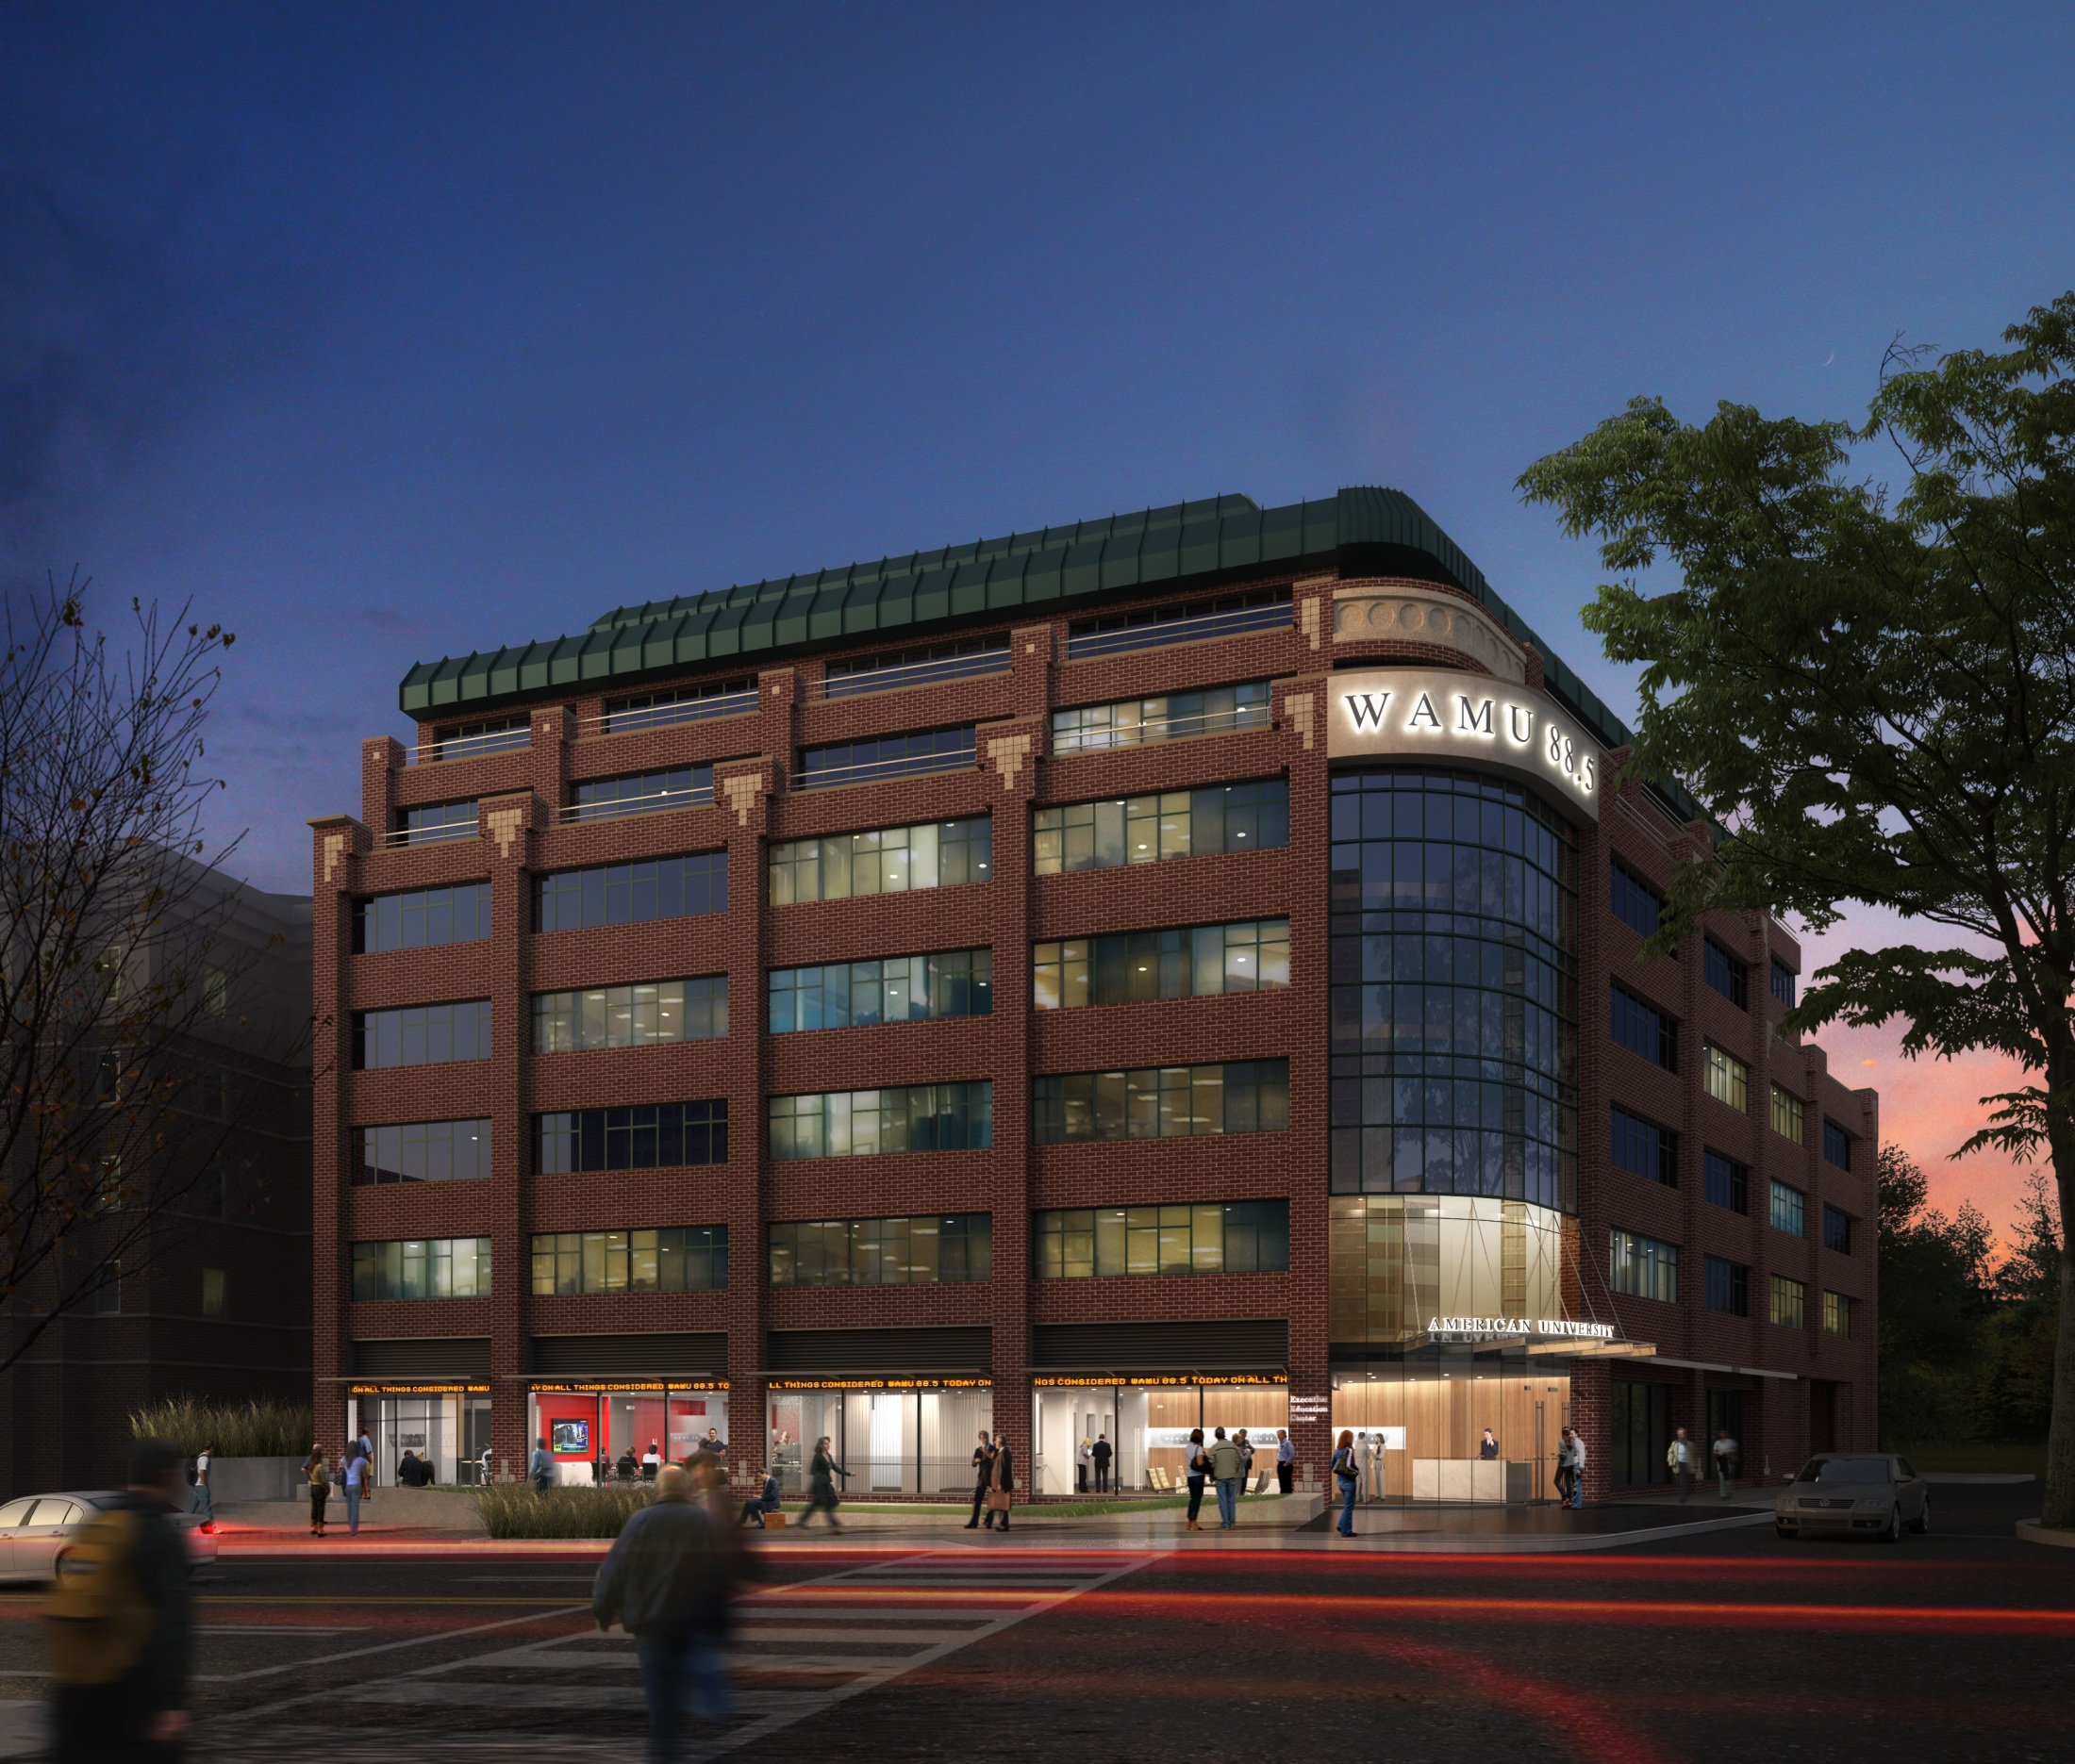
4401 Connecticut Planning
January 14, 2013

Slide 2
General Information
Originally built in 1987, authorized under a Planned Unit Development (PUD)
96,000 square feet, general office and retail
Planned occupants are WAMU-FM and university administrative offices
Existing retail to remain
Design-Build Team
Gensler Architects
Coakley Williams Construction

Slide 3
Schedule
Purchased by AU in May 2012
Construction started November 2012
Permits application November 2012
Permit issuance expected January 2013
Scheduled move-in May 2013

Slide 4
Planned Changes
Interior renovation
Entrance replacement
Connecticut Avenue storefront and awning replacement
Connecticut Avenue streetscape upgrade
Adding rooftop antennas

Slide 5
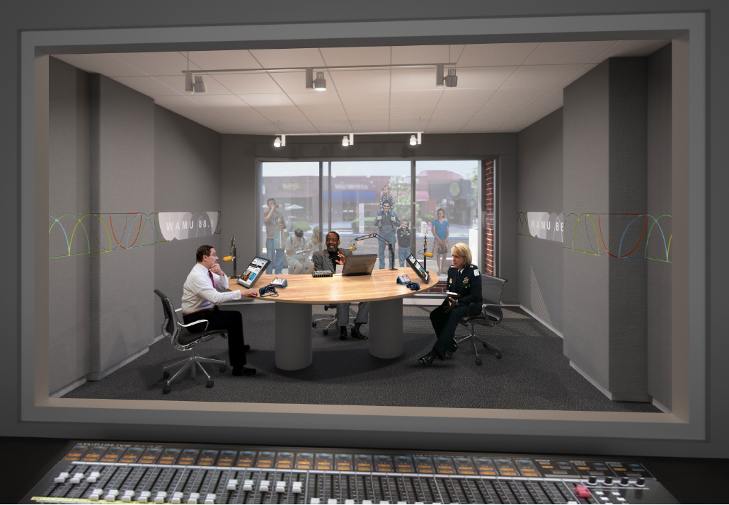
WAMU Interior Renovations
Audience Studio
Street View Studio

Slide 6
WAMU Interior Renovations
Community Room
Street View of News Room

Slide 7
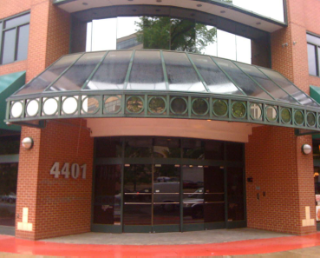
Entrance Changes
Planned
Existing

Slide 8
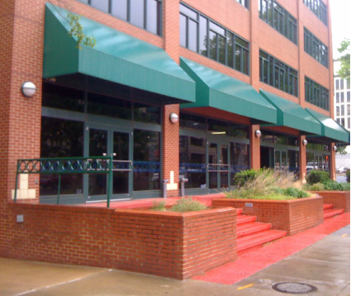
Storefront and Awning Changes
Planned
Existing

Slide 9
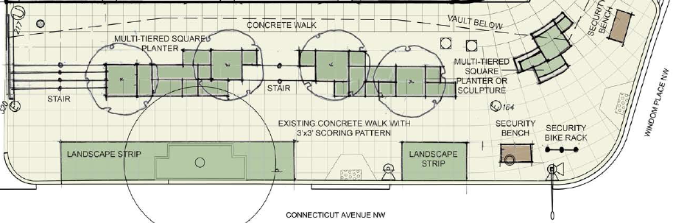
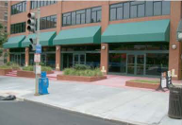
Public Space Changes
Planned
Existing

Slide 10
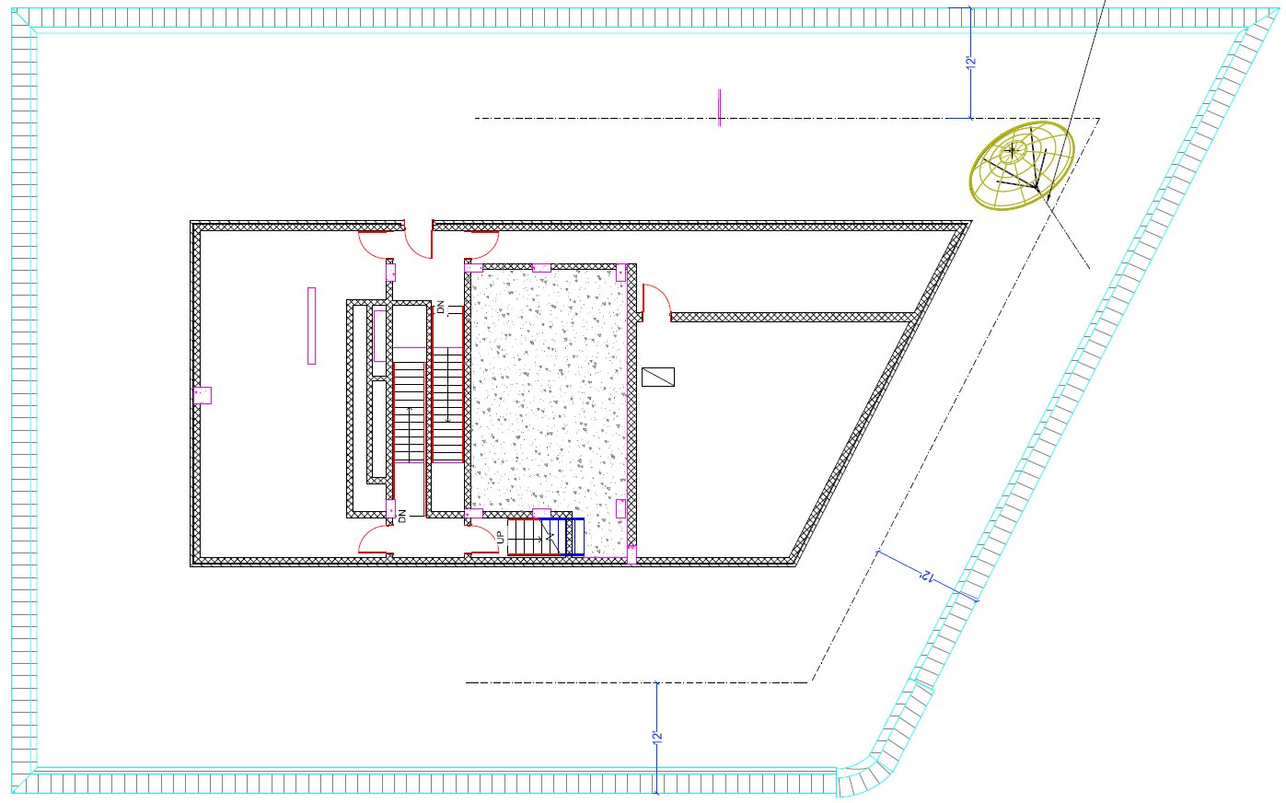
Rooftop Antennas
Satellite dish and whip antennas
All comply with antenna regulations
Connecticut Ave

Slide 11
Questions

